Slide 1
Introduction to Computer Graphics with WebGL
Ed Angel
Professor Emeritus of Computer Science
Founding Director, Arts, Research, Technology and Science Laboratory
University of New Mexico
Angel and Shreiner: Interactive Computer Graphics 7E © Addison-Wesley 2015

Slide 2
Curves and Surfaces
Ed Angel
Professor Emeritus of Computer Science
University of New Mexico
Angel and Shreiner: Interactive Computer Graphics 7E © Addison-Wesley 2015

Slide 3
Objectives
Introduce types of curves and surfaces
  Explicit
  Implicit
  Parametric
  Strengths and weaknesses
Discuss Modeling and Approximations
  Conditions
  Stability
Angel and Shreiner: Interactive Computer Graphics 7E © Addison-Wesley 2015

Slide 4
Escaping Flatland
Until now we have worked with flat entities such as lines and flat polygons
  Fit well with graphics hardware
  Mathematically simple
But the world is not composed of flat entities
  Need curves and curved surfaces
  May only have need at the application level
  Implementation can render them approximately with flat primitives
Angel and Shreiner: Interactive Computer Graphics 7E © Addison-Wesley 2015

Slide 5
Modeling with Curves
interpolating data point
data points
approximating curve
Angel and Shreiner: Interactive Computer Graphics 7E © Addison-Wesley 2015

Slide 6
What Makes a Good Representation?
There are many ways to represent curves and surfaces
Want a representation that is
  Stable
  Smooth
  Easy to evaluate
  Must we interpolate or can we just come close to data?
  Do we need derivatives?
Angel and Shreiner: Interactive Computer Graphics 7E © Addison-Wesley 2015

Slide 7
Explicit Representation
Most familiar form of curve in 2D
  y=f(x)
Cannot represent all curves
  Vertical lines
  Circles
Extension to 3D
  y=f(x), z=g(x)
  The form z = f(x,y) defines a surface
y
x
y
x
z
Angel and Shreiner: Interactive Computer Graphics 7E © Addison-Wesley 2015

Slide 8
Implicit Representation
Two dimensional curve(s)
  g(x,y)=0
Much more robust
  All lines ax+by+c=0
  Circles x²+y²-r²=0
Three dimensions g(x,y,z)=0 defines a surface
  Intersect two surface to get a curve
In general, we cannot solve for points that satisfy
Angel and Shreiner: Interactive Computer Graphics 7E © Addison-Wesley 2015

Slide 9
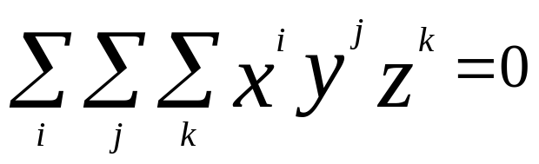
Algebraic Surface
Quadric surface 2 ≥ i+j+k
At most 10 terms
Can solve intersection with a ray by
reducing problem to solving quadratic equation
Angel and Shreiner: Interactive Computer Graphics 7E © Addison-Wesley 2015

Slide 10
Parametric Curves
Separate equation for each spatial variable
  x=x(u)
  y=y(u)
  z=z(u)
For u_{max} ≥ u ≥ u_{min} we trace out a curve in two or three dimensions
p(u)=[x(u), y(u), z(u)]^{T}
p(u)
p(u_{max})
p(u_{min})
Angel and Shreiner: Interactive Computer Graphics 7E © Addison-Wesley 2015

Slide 11
Selecting Functions
Usually we can select “good” functions
  not unique for a given spatial curve
  Approximate or interpolate known data
  Want functions which are easy to evaluate
  Want functions which are easy to differentiate
    Computation of normals
    Connecting pieces (segments)
  Want functions which are smooth
Angel and Shreiner: Interactive Computer Graphics 7E © Addison-Wesley 2015

Slide 12
Parametric Lines
We can normalize u to be over the interval (0,1)
Line connecting two points p₀ and p₁
p(1)= p₁
p(u)=(1-u)p₀+up₁
p(0) = p₀
p(1)= p₀ +d
Ray from p₀ in the direction d
p(u)=p₀+ud
d
p(0) = p₀
Angel and Shreiner: Interactive Computer Graphics 7E © Addison-Wesley 2015

Slide 13
Parametric Surfaces
Surfaces require 2 parameters
x=x(u,v)
y=y(u,v)
z=z(u,v)
p(u,v) = [x(u,v), y(u,v), z(u,v)]^{T}
Want same properties as curves:
  Smoothness
  Differentiability
  Ease of evaluation
y
p(u,1)
p(0,v)
p(1,v)
x
z
p(u,0)
Angel and Shreiner: Interactive Computer Graphics 7E © Addison-Wesley 2015

Slide 14
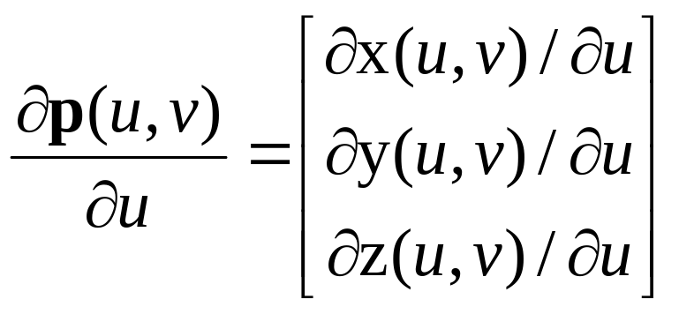
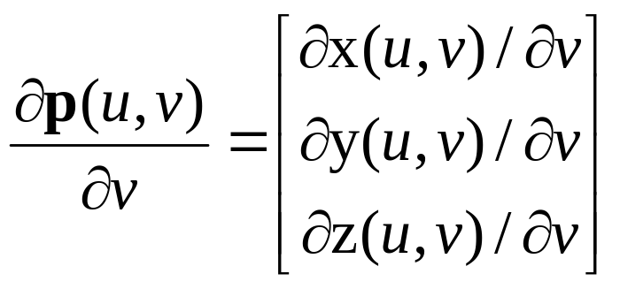
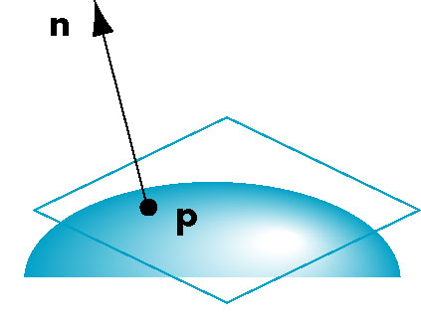
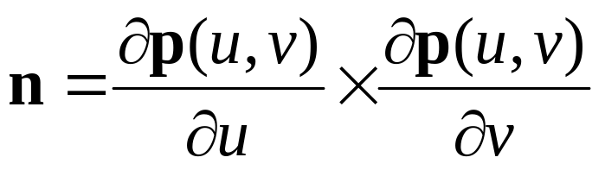
Normals
We can differentiate with respect to u and v to obtain the normal at any point p
Angel and Shreiner: Interactive Computer Graphics 7E © Addison-Wesley 2015

Slide 15
Parametric Planes
n
point-vector form
r
p(u,v)=p₀+uq+vr
n = q x r
q
p₀
n
three-point form
p₂
q = p₁ – p₀
r = p₂ – p₀
p₁
p₀
Angel and Shreiner: Interactive Computer Graphics 7E © Addison-Wesley 2015

Slide 16
Parametric Sphere
x(u,v) = r cos θ sin φ
y(u,v) = r sin θ sin φ
z(u,v) = r cos φ
360 ≥ θ ≥ 0
180 ≥ φ ≥ 0
constant: circles of constant longitude
φ constant: circles of constant latitude
differentiate to show n = p
Angel and Shreiner: Interactive Computer Graphics 7E © Addison-Wesley 2015

Slide 17
Curve Segments
After normalizing u, each curve is written
p(u)=[x(u), y(u), z(u)]^{T}, 1 ≥ u ≥ 0
In classical numerical methods, we design a single global curve
In computer graphics and CAD, it is better to design small connected curve segments
p(u)
join point p(1) = q(0)
q(1)
q(u)
p(0)
Angel and Shreiner: Interactive Computer Graphics 7E © Addison-Wesley 2015

Slide 18
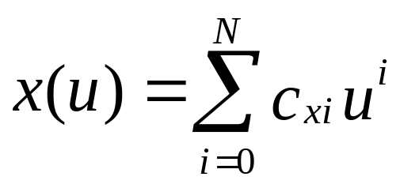
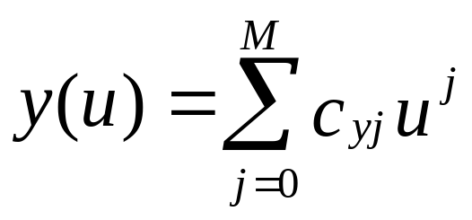
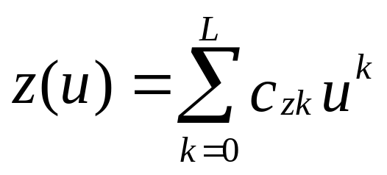
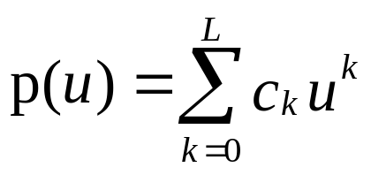
Parametric Polynomial Curves
If N=M=K, we need to determine 3(N+1) coefficients
Equivalently we need 3(N+1) independent conditions
Noting that the curves for x, y and z are independent,
we can define each independently in an identical manner
We will use the form
where p can be any of x, y, z
Angel and Shreiner: Interactive Computer Graphics 7E © Addison-Wesley 2015

Slide 19
Why Polynomials
Easy to evaluate
Continuous and differentiable everywhere
  Must worry about continuity at join points including continuity of derivatives
p(u)
q(u)
join point p(1) = q(0)
but p’(1) ≠ q’(0)
Angel and Shreiner: Interactive Computer Graphics 7E © Addison-Wesley 2015

Slide 20
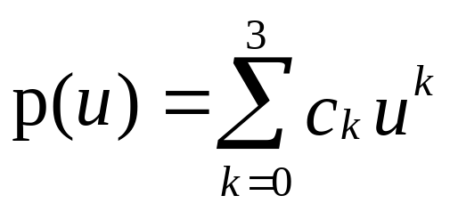
Cubic Parametric Polynomials
N=M=L=3, gives balance between ease of evaluation and flexibility in design
Four coefficients to determine for each of x, y and z
Seek four independent conditions for various values of u resulting in 4 equations in 4 unknowns for each of x, y and z
  Conditions are a mixture of continuity requirements at the join points and conditions for fitting the data
Angel and Shreiner: Interactive Computer Graphics 7E © Addison-Wesley 2015

Slide 21
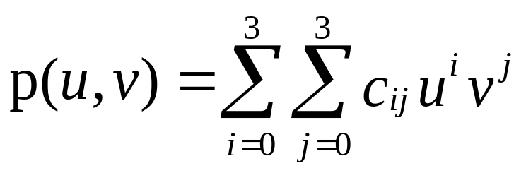
Cubic Polynomial Surfaces
p(u,v)=[x(u,v), y(u,v), z(u,v)]^{T}
where
p is any of x, y or z
Need 48 coefficients ( 3 independent sets of 16) to
determine a surface patch
Angel and Shreiner: Interactive Computer Graphics 7E © Addison-Wesley 2015

